Slide 1
Space-efficient quantum multiplication of polynomials for binary finite fields
최승주
https://youtu.be/-hpZiDPcOO4

Slide 2
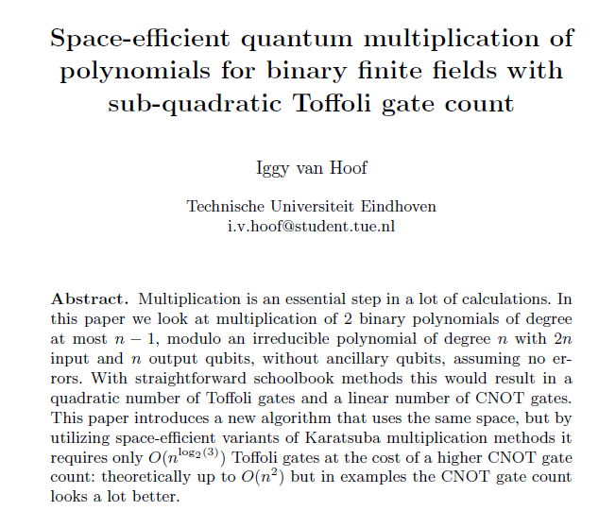
Space Efficient Multiplication

Slide 3
Space Efficient Multiplication
유한체 상에서 다항식간의 곱셈 - 일반 컴퓨터에서는 카라추바 곱셈 기법을 기반으로 한 다양한 방식이 존재
차수가 n인 다항식을 연산하기 위해서는 2n 만큼의 공간을 사용했었음 - n → O(long n) → 0(본 논문)
카라추바만큼 계산 속도라 빠른 다른 곱셈 제안 기법들은 다 추가적인 공간을 사용함 - 본 논문에서는 추가 공간을 사용하지 않음

Slide 4
Karatsuba Algorithm
아나톨리 알렉세예비치 카라추바 - 큰 수들의 곱을 빠르게 진행할 수 있는 알고리즘
x = x₁B^{m}+x₀ y = y₁B^{m}+y₀ z₂ = x₁y₁ z₁ = x₁y₀ + x₀y₁ z₀ = x₀y₀ xy = (x₁B^{m}+x₀)(y₁B^{m}+y₀) = z₂B^{2m} + z₁B^{m}+z₀

Slide 5
Karatsuba Algorithm
x = x₁B^{m}+x₀ y = y₁B^{m}+y₀ z₂ = x₁y₁ z₀ = x₀y₀ z₁ = x₁y₀ + x₀y₁ = (x₁y₁ + x₁y₀₊ x₀y₁ + x₀y₀)- x₁y₁ + x₀y₀ = (x₁+ x₀)(y₁ + y₀) - z₂ - z₀

Slide 6
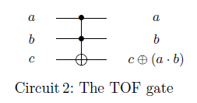
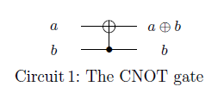

Space Efficient Multiplication
xor
AND
INDEX

Slide 7
Space Efficient Multiplication
Addition → CNOT - 차수가 n인 다항식간의 덧셈은 n+1개의 CNOT 사용 - 결과가 input 자리를 대신해서 들어감
x₀
x₁
y₀
y₁
r₀
r₁
r₀
r₁

Slide 8
Space Efficient Multiplication
Addition → CNOT - 차수가 n인 다항식간의 덧셈은 n+1개의 CNOT 사용 - 결과가 input 자리를 대신해서 들어감
x+1
x
1
1
0
1
1
0
0
1
(x+1) + (x) = 2x = 1

Slide 9
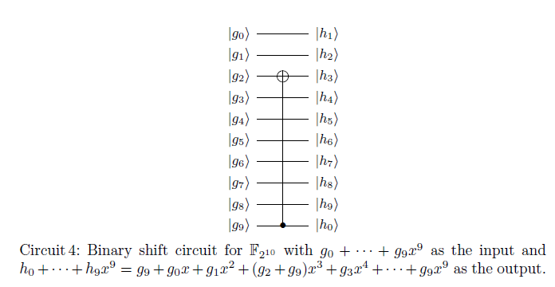
Space Efficient Multiplication
Binary Shift
8

Slide 10
Space Efficient Multiplication
multiplication with x
Binary Shift
1
x
x²
x³
x⁴
x⁵
x⁶
x⁷
x⁸
x⁹
x
x²
x³
x⁴
x⁵
x⁶
x⁷
x⁸
x⁹
x¹⁰
x^{1 mod n}
m(x) = 1 + x³ + x¹⁰ → x¹⁰ = x³ + 1
8

Slide 11
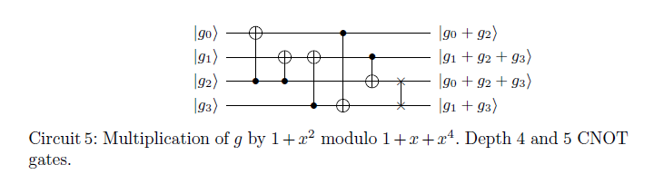
Space Efficient Multiplication
Multiplication by a constant polynomial

Slide 12
Space Efficient Multiplication
Constant polynomial
y
y
1
x
x
y = x
f(x) = x
f(x) = 1

Slide 13
Space Efficient Multiplication
Multiplication by a constant polynomial
g₀+g₂
g₁+g₂
g₁+g₂+g₃
g₁+g₃
g₀+g₂+g₃

Slide 14
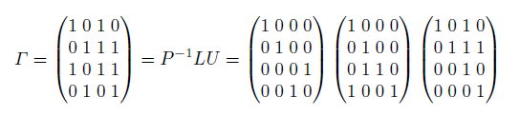
Space Efficient Multiplication
Multiplication by a constant polynomial

Slide 15
Space Efficient Multiplication
LUP Decomposition
3x + 4y + 2z = 15
5x + 2y + 1z = 18
2x + 3y + 2z = 10
1 0 0
l₂₁ 1 0 l₃₁ l₃₂ 1
u₁₁ u₁₂ u₁₃
0 u₂₂ u₂₃ 0 0 u₃₃
L =
U =
1. Ax = B
2. A = LU LUX = B
3. LY = B where UX = Y
4. UX = Y
y₁
y₂
y₃
Y =

Slide 16
Space Efficient Multiplication
LUP Decomposition
3x + 4y + 2z = 15
5x + 2y + 1z = 18
2x + 3y + 2z = 10
1 0 0
l₂₁ 1 0 l₃₁ l₃₂ 1
u₁₁ u₁₂ u₁₃
0 u₂₂ u₂₃ 0 0 u₃₃
L =
U =
1. Ax = B
2. A = LU LUX = B
3. LY = B where UX = Y
4. UX = Y
y₁
y₂
y₃
Y =
3 4 2
5 2 1 2 3 2
x₁
x₂
x₃
15
18
10
A =
X =
B =

Slide 17
Space Efficient Multiplication
LUP Decomposition
3x + 4y + 2z = 15
5x + 2y + 1z = 18
2x + 3y + 2z = 10
1 0 0
l₂₁ 1 0 l₃₁ l₃₂ 1
u₁₁ u₁₂ u₁₃
0 u₂₂ u₂₃ 0 0 u₃₃
L =
U =
1. Ax = B
2. A = LU LUX = B
3. LY = B where UX = Y
y₁
y₂
y₃
4. UX = Y
Y =
3 4 2
5 2 1 2 3 2
x₁
x₂
x₃
15
18
10
A =
X =
B =
3 4 2
5 2 1 2 3 2
u₁₁ u₁₂ u₁₃
l₂₁u₁₁ l₂₁u₁₂+u₂₂ l₂₁u₁₃+u₂₃ l₃₁u₁₁ l₃₁u₁₂+l₃₂u₂₂ l₃₁u₁₃+l₃₂u₂₃₊u₃₃
A =
= LU =

Slide 18
Space Efficient Multiplication
LUP Decomposition
3x + 4y + 2z = 15
5x + 2y + 1z = 18
2x + 3y + 2z = 10
1 0 0
l₂₁ 1 0 l₃₁ l₃₂ 1
u₁₁ u₁₂ u₁₃
0 u₂₂ u₂₃ 0 0 u₃₃
L =
U =
1. Ax = B
2. A = LU LUX = B
3. LY = B where UX = Y
y₁
y₂
y₃
4. UX = Y
Y =
3 4 2
5 2 1 2 3 2
x₁
x₂
x₃
15
18
10
A =
X =
B =
3 4 2
5 2 1 2 3 2
u₁₁ u₁₂ u₁₃
l₂₁u₁₁ l₂₁u₁₂+u₂₂ l₂₁u₁₃+u₂₃ l₃₁u₁₁ l₃₁u₁₂+l₃₂u₂₂ l₃₁u₁₃+l₃₂u₂₃₊u₃₃
U₁₁ = 3, U₁₂ = 4, U₁₃ = 2 l₂₁ = 5/3, U₂₂ = -14/3, U₂₃ = -7/3 l₃₁ = 2/3, l₃₂ = -1/14, U₃₃ = 1/2
A =
=

Slide 19
Space Efficient Multiplication
LUP Decomposition
3x + 4y + 2z = 15
5x + 2y + 1z = 18
2x + 3y + 2z = 10
1 0 0
l₂₁ 1 0 l₃₁ l₃₂ 1
u₁₁ u₁₂ u₁₃
0 u₂₂ u₂₃ 0 0 u₃₃
L =
U =
1. Ax = B
2. A = LU LUX = B
3. LY = B where UX = Y
y₁
y₂
y₃
4. UX = Y
Y =
3 4 2
5 2 1 2 3 2
x₁
x₂
x₃
15
18
10
A =
X =
B =
U₁₁ = 3, U₁₂ = 4, U₁₃ = 2 l₂₁ = 5/3, U₂₂ = -14/3, U₂₃ = -7/3 l₃₁ = 2/3, l₃₂ = -1/14, U₃₃ = 1/2
1 0 0
5/3 1 0 2/3 -1/14 1
y₁
y₂
y₃
15
18
10
=
y₁ = 15, y₂ = -7, y₃ = -1/2

Slide 20
Space Efficient Multiplication
LUP Decomposition
3x + 4y + 2z = 15
5x + 2y + 1z = 18
2x + 3y + 2z = 10
1 0 0
l₂₁ 1 0 l₃₁ l₃₂ 1
u₁₁ u₁₂ u₁₃
0 u₂₂ u₂₃ 0 0 u₃₃
L =
U =
1. Ax = B
2. A = LU LUX = B
3. LY = B where UX = Y
y₁
y₂
y₃
4. UX = Y
Y =
U₁₁ = 3, U₁₂ = 4, U₁₃ = 2 l₂₁ = 5/3, U₂₂ = -14/3, U₂₃ = -7/3 l₃₁ = 2/3, l₃₂ = -1/14, U₃₃ = 1/2
y₁ = 15, y₂ = -7, y₃ = -1/2
3 4 2
0 -14/3 -7/3 0 0 1/2
x₁
x₂
x₃
15
-7
-1/2
x₁
x₂
x₃
3
2
-1
U =
=
=

Slide 21
Space Efficient Multiplication
Multiplication by a constant polynomial
1 + x + x² + x³
1 + x²
x + x²
1
1
1
1
0
1
1
0

Slide 22
Space Efficient Multiplication
Multiplication by a constant polynomial
1 + x + x² + x³
1 + x³
x + x² + x³
1
1
1
1
0
1
1
1

Slide 23
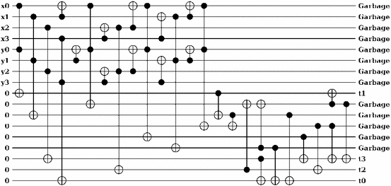
Space Efficient Multiplication

